Slide 1
Analyzing the Impact of Weather on Restaurant Customer Ratings in Chicago
Natalie Loecher
April 27, 2025

Slide 2
Background & Purpose of Analysis
The Starbucks Reserve Roastery in Chicago is the largest Starbucks in the world, attracting thousands of visitors each week.
Customer ratings are critical for restaurants, but many factors can influence it including external conditions like weather. Bad weather (rain, snow, extreme cold) might discourage people from visiting or could negatively affect their experience.
The question is: Does weather impact how customers rate their dining experience.
The project will also extend to two popular cafes in Chicago, Café Con Leche and Upstairs at the Gwen. This will provide more feedback to see if the ratings are similar for all three with specific weather conditions and experiences.

Slide 3
Data Sources
There are two main sources for collecting the data needed for this analysis.
Restaurant Reviews data came from the website OpenTable, which provides ratings and reviews for certain restaurants. This data was scraped and was only between the time frame of April 1 2023-April 1 2025.
Weather data came from Visual Crossing and provides daily historical data from April 1 2023-April 1 2025.
All the data was cleaned and merged to connect the days with reviews with the specific weather that day.

Slide 4
Research Question 1: Does customer satisfaction change based on weather conditions?
A test was run by comparing the average ratings across weather types(sunny, cloudy, rainy, etc.)
This was then visualized using a bar chart.
Finally, a one-way ANOVA test was performed to check for significant differences.

Slide 5
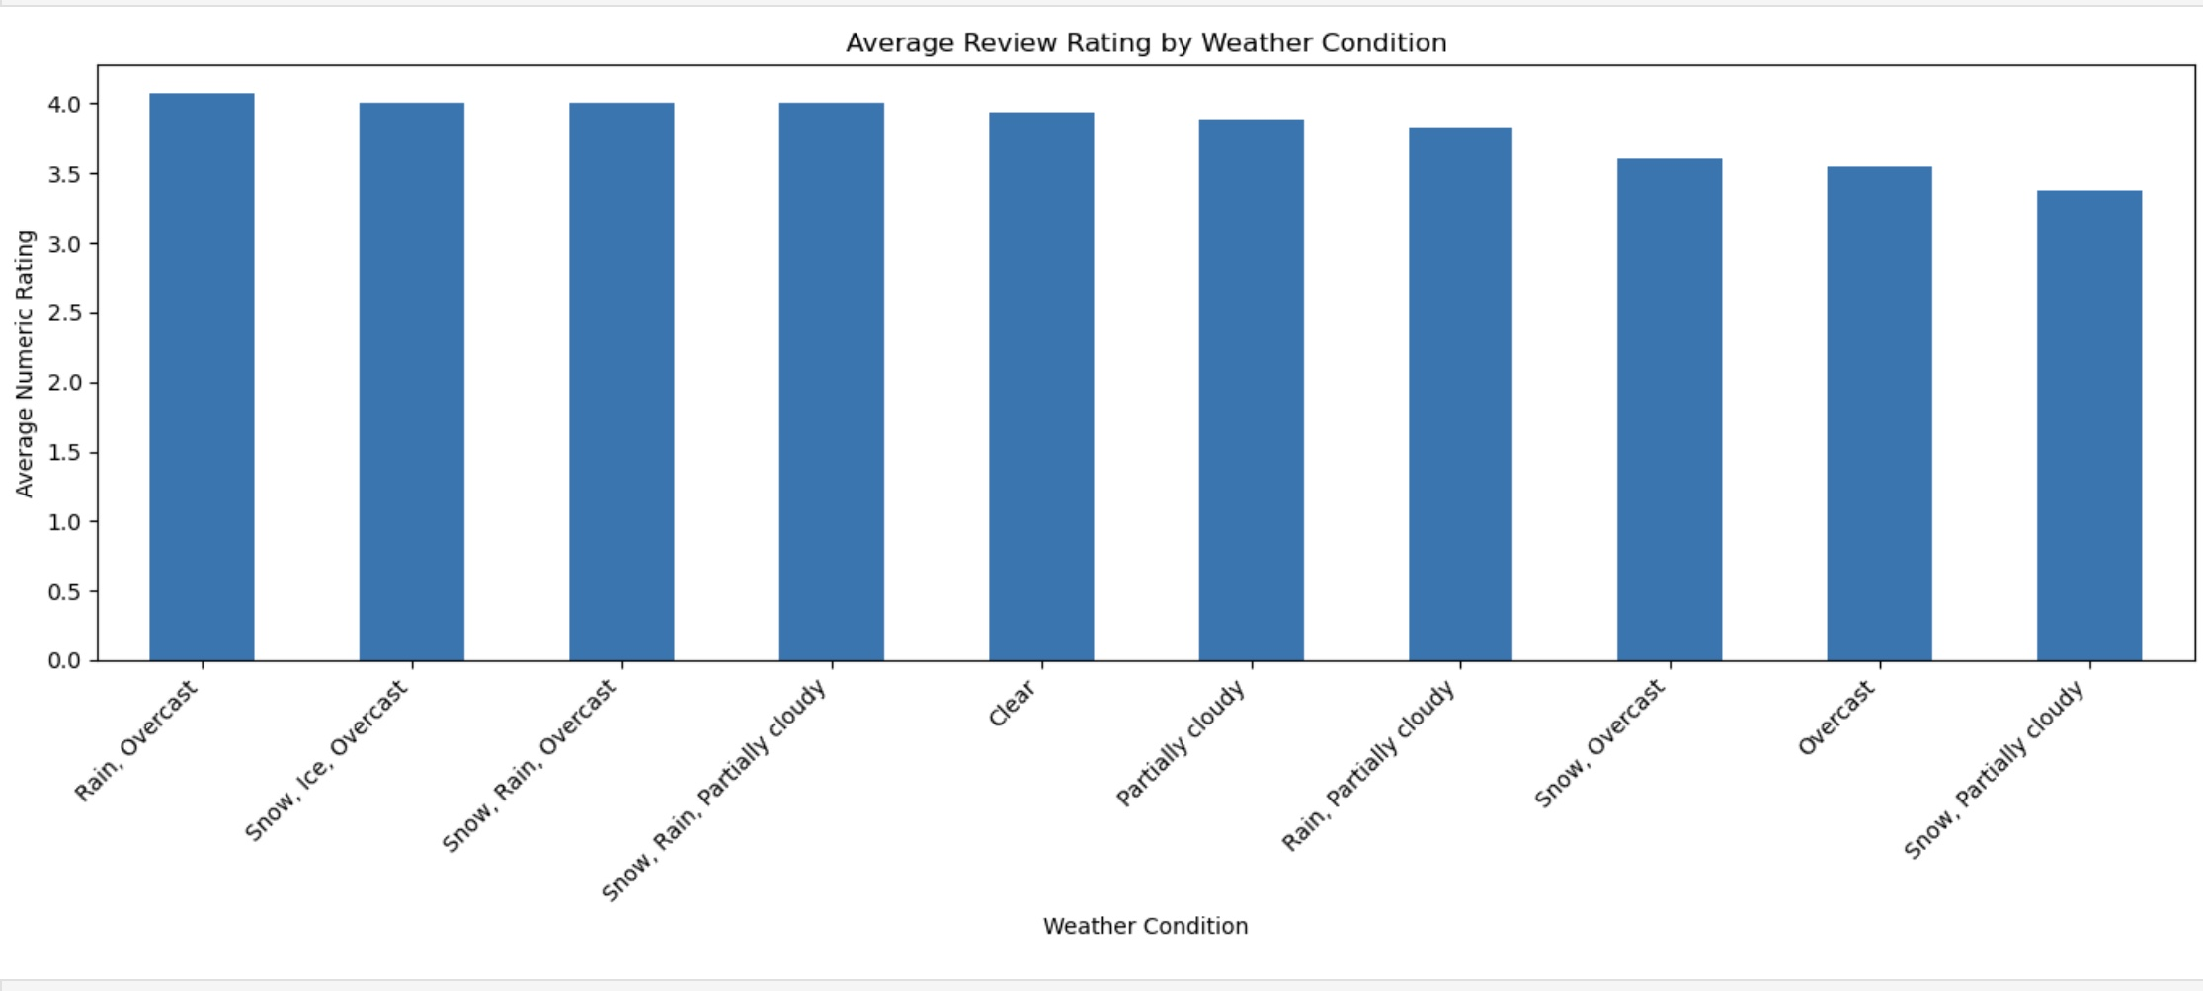
Results to Question 1
Average Ratings Bar Chart
One-way ANOVA Test
F-Statistic: .55 (Low)
P Value: .837 (High)
Result: Fail to reject H₀: No significant difference in ratings across weather types.
The F-statistic was low, and the p-value was much greater than 0.05, meaning that any differences we saw are probably due to random variation. Therefore, weather doesn’t significantly affect customer satisfaction based on our current data.

Slide 6
Research Question 2: Can customer ratings be predicted based on temperature?
A scatter plot was created to visualize the relationship between average daily temperature and customer star ratings.
A Shapiro-Wilk test confirmed whether the residuals from the regression model were normally distributed, validating model assumptions.
Three regression models were tested: Linear, Ridge, and Lasso.
The models were evaluated using R² scores to assess how well temperature predicted customer satisfaction.
Results showed that temperature had a very weak predictive relationship with ratings, and regularization (Ridge/Lasso) did not significantly improve model performance.

Slide 7
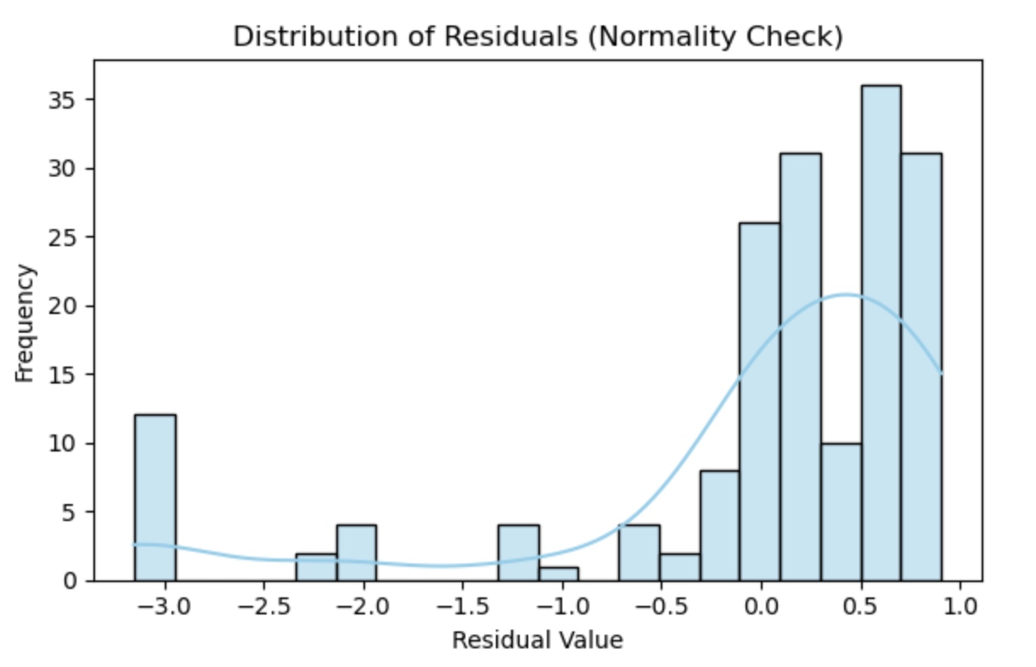
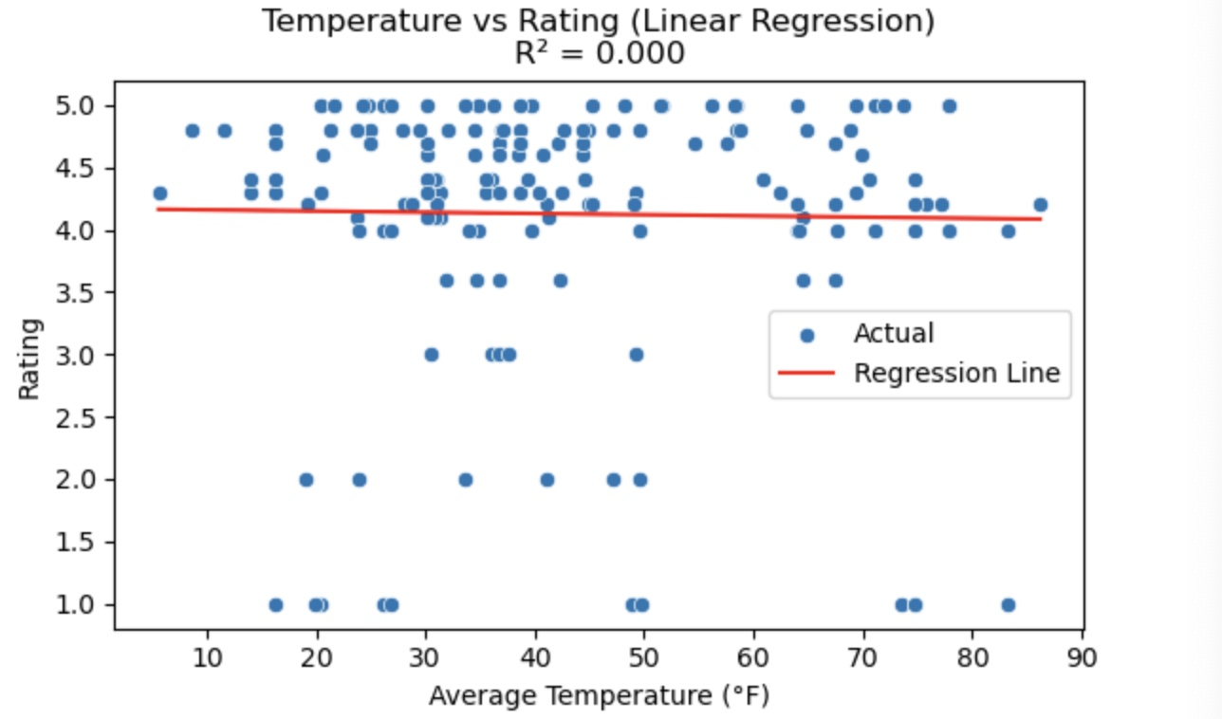
Results to Question 2
Scatter Plot with Regression Line
Shapiro-Wilk Test:
Statistic = .7163 P-value = .00000
Residuals are not normally distributed

Slide 8
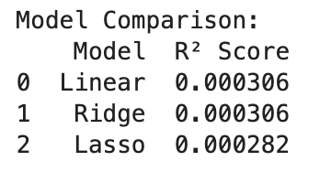
Results to Question 2 Continued
All three models (Linear, Ridge, Lasso) produced very low R² scores (~0.0003), indicating that temperature does not meaningfully predict customer ratings. Other factors likely have a much greater impact on satisfaction.

Slide 9
Research Question 3: Do customer ratings vary between different restaurant locations?
Average ratings were compared for three locations:
-Starbucks Reserve
-Café Con Leche
-Upstairs at the Gwen
Differences in rating distributions were visualized using box plots.
A one-way ANOVA test was conducted to evaluate if mean ratings significantly differ by location.

Slide 10
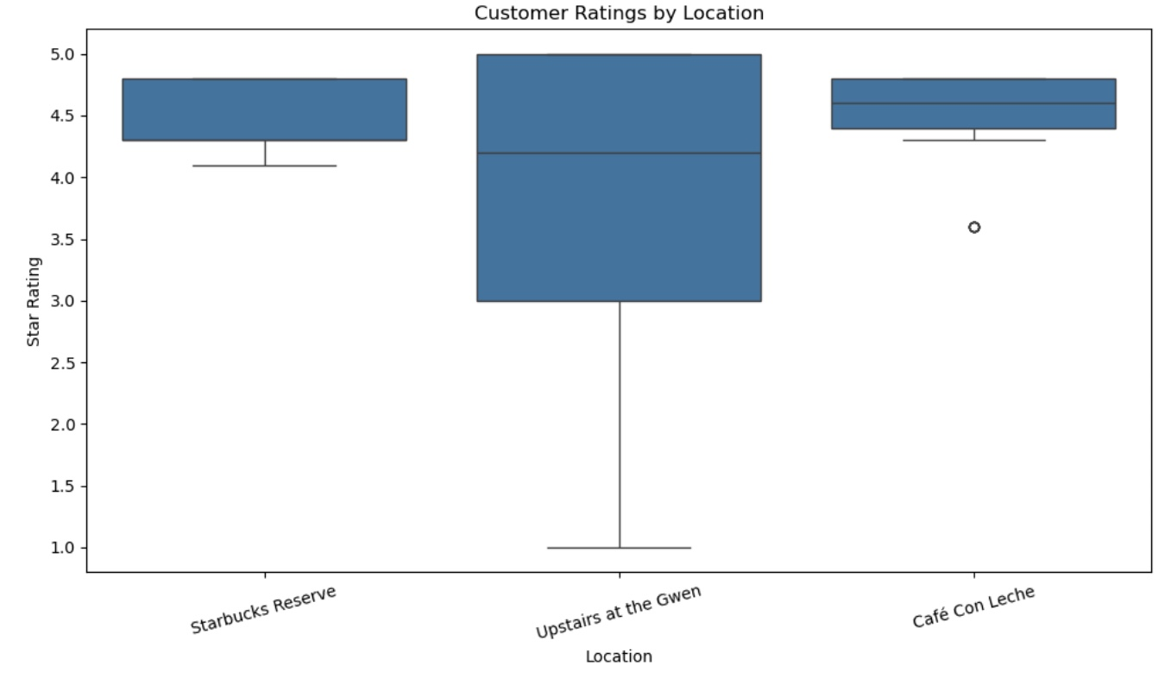
Results to Question 3
Box Plot
One-way ANOVA Test
A one-way ANOVA test revealed a statistically significant difference in average customer ratings between the three restaurant locations (F statistic = 10.059, P-Value = .0000748)
This suggests that at least one location has a notably different average rating, supporting the hypothesis that location influences customer satisfaction.

Slide 11
Challenges
The only challenged that have been experienced are that for the first research question that result was not what was expected/predicted. It was initially believed that there would be a significant difference in ratings based on the weather but that was not seen.

